Slide 1
JSON-Based Document

Slide 2
JSON-Based Document : -
MongoDB uses a JSON-based (JSON stands for JavaScript Object Notation) document store for the data.
JSON/BSON (BSON stands for Binary JSON) offers a schema-less model, which provides flexibility in terms of database design.
Unlike in RDBMSs, changes can be done to the schema seamlessly.
This design also makes for high performance by providing for grouping of relevant data together internally and making it easily searchable.
A JSON document contains the actual data and is comparable to a row in SQL.
However, in contrast to RDBMS rows, documents can have dynamic schema.
This means documents within a collection can have different fields or structure, or common fields can have different type of data.
A document contains data in form of key-value pairs.

Slide 3
For example: -
{
"Name": "ABC",
"Phone": ["1111111", ........"222222" ........],
"Fax":..
}
Note: -
As mentioned, keys and values come in pairs.
The value of a key in a document can be left blank.
In the above example, the document has three keys, namely “Name,” ”Phone,” and “Fax.” The “Fax” key has no value.

Slide 4
JSON or JavaScript Object Notation is a lightweight text-based open standard designed for human-readable data interchange.
Conventions used by JSON are known to programmers, which include C, C++, Java, Python, Perl, etc.
• JSON stands for JavaScript Object Notation.
• The format was specified by Douglas Crockford.
• It was designed for human-readable data interchange.
• It has been extended from the JavaScript scripting language.
• The filename extension is .json.
• JSON Internet Media type is application/json.
• The Uniform Type Identifier is public.json.

Slide 5
Use of JSON
It is used while writing JavaScript based applications that includes browser extensions and websites.
• JSON format is used for serializing and transmitting structured data over network connection.
• It is primarily used to transmit data between a server and web applications.
• Web services and APIs use JSON format to provide public data.
• It can be used with modern programming languages.

Slide 6
Characteristics
• JSON is easy to read and write.
• It is a lightweight text-based interchange format.
• JSON is language independent

Slide 7
Example
The following example shows how to use JSON to store information related to books based on their topic and edition.
{
"book": [
{
"id":"01",
"language": "Java",
"edition": "third",
"author": "Herbert Schildt"
},
{
"id":"07",
"language": "C++",
"edition": "second"
"author": "E.Balagurusamy"
}]
}

Slide 8
After understanding the above program, we will try another example. Let's save the below code as json
<html>
<head>
<title>JSON example</title>
<script language="javascript" >
var object1 = { "language" : "Java", "author" : "herbert schildt" };
document.write("<h1>JSON with JavaScript example</h1>");
document.write("<br>");
document.write("<h3>Language = " + object1.language+"</h3>");
document.write("<h3>Author = " + object1.author+"</h3>");
var object2 = { "language" : "C++", "author" : "E-Balagurusamy" };
document.write("<br>");
document.write("<h3>Language = " + object2.language+"</h3>");
document.write("<h3>Author = " + object2.author+"</h3>");

Slide 9
document.write("<hr />");
document.write(object2.language + " programming language can be studied " +
"from book written by " + object2.author);
document.write("<hr />");
</script>
</head>
<body>
</body>
</html>

Slide 10
Syntax
Let's have a quick look at the basic syntax of JSON. JSON syntax is basically considered as a subset of JavaScript syntax; it includes the following:
• Data is represented in name/value pairs.
• Curly braces hold objects and each name is followed by ':'(colon), the name/value pairs are separated by , (comma).
• Square brackets hold arrays and values are separated by ,(comma).

Slide 11
Example
{
"book": [
{
"id":"01",
"language": "Java",
"edition": "third",
"author": "Herbert Schildt"
},
{
"id":"07",
"language": "C++",
"edition": "second"
"author": "E.Balagurusamy"
}]
}

Slide 12
JSON supports the following two data structures:
• Collection of name/value pairs: This Data Structure is supported by different programming languages.
• Ordered list of values: It includes array, list, vector or sequence etc.

Slide 13
Data types
Number
• It is a double precision floating-point format in JavaScript and it depends on implementation.
• Octal and hexadecimal formats are not used.
• No NaN or Infinity is used in Number.

Slide 14
String
• It is a sequence of zero or more double quoted Unicode characters with backslash escaping.
• Character is a single character string i.e. a string with length 1.
Boolean
It includes true or false values.

Slide 15
Array
• It is an ordered collection of values.
• These are enclosed in square brackets which means that array begins with .[. and ends with .]..
• The values are separated by , (comma).
• Array indexing can be started at 0 or 1.
• Arrays should be used when the key names are sequential integers.

Slide 16
Object
• It is an unordered set of name/value pairs.
• Objects are enclosed in curly braces that is, it starts with '{' and ends with '}'.
• Each name is followed by ':'(colon) and the name/value pairs are separated by , (comma).
• The keys must be strings and should be different from each other.
• Objects should be used when the key names are arbitrary strings.

Slide 17
Json values
It includes:
• number (integer or floating point)
• string
• boolean
• array
• object
• null

Slide 18
Example
var i =1;
var j = "sachin";
var k = null;

Slide 19
Creating Simple Objects
JSON objects can be created with JavaScript. Let us see the various ways of creating JSON objects using JavaScript:
To Create an empty Object:
var JSONObj = {};
To Create a new Object:
var JSONObj = new Object();

Slide 20
SCHEMA
JSON Schema is a specification for JSON based format for defining the structure of JSON data. It was written under IETF draft which expired in 2011. JSON Schema:
• Describes your existing data format.
• Clear, human- and machine-readable documentation.
• Complete structural validation, useful for automated testing.
• Complete structural validation, validating client-submitted data.
JSON Schema Validation Libraries
There are several validators currently available for different programming languages. Currently the most complete and compliant JSON Schema validator available is JSV.

Slide 21
JSON Schema Example
{
"$schema": "http://json-schema.org/draft-04/schema#",
"title": "Product",
"description": "A product from Acme's catalog",
"type": "object",
"properties": {
"id": {
"description": "The unique identifier for a product",
"type": "integer"
},
"name": {
"description": "Name of the product",
"type": "string"
},
"price": {
"type": "number",
"minimum": 0,
"exclusiveMinimum": true
}
},
"required": ["id", "name", "price"]
}

Slide 22
COMPARISION

Slide 23
JSON WITH COGNOS

Slide 24
spec.json description
The spec.json file in an extension defines the additions and deletions the extension makes to the default IBM® Cognos® Analytics user interface. The structure and contents of this file are explained here.
The structure and contents that are described here are provisional. They can change in future releases of Cognos Analytics. These changes may not be backward compatible.
nameSpecifies the name of the extension. The name can contain alphanumeric characters, underscores (_), and spaces ( ).schemaVersionSpecifies a numeric value for the schema version. Can be 1.0 or 2.0. The default value is 1.0.
extensionsContains an array of perspective objects.perspectiveSpecifies the view that is being extended. The options are the following.

Slide 25
Cont ...
commonApplies to all views.
<view_name>Applies to the <view_name> view, which can be a built-in view (home, authoring, dashboard, or modeller) or an uploaded view.
typeIf the extension is a view, specifies the type. The possible values are login for a sign-in view and home for a home view. This element is only used in schema version 2.0. If it is omitted and schema version 2.0 is specified, then the view is not included in the list of possible default home or sign-in views.lensableIf false, this view is not included in the list of views for which features can be omitted. For more information, see Customizing roles.The default value is true.

Slide 26
JSON schema validation

Slide 27
Type the following command to copy the JSON code from DASHBOARD
Ctrl + / + q

Slide 28
{ "type": "object", "definitions": { "extType": { "type": "string", "minLength": 1, "pattern": "^v1/ext/.+$" }, "noEmptyString": { "type": "string", "minLength": 1 }, "toolItem": { "type": "object", "properties": { "id": { "$ref": "#/definitions/noEmptyString" }, "title": { "type": "string" }, "type": { "$ref": "#/definitions/noEmptyString" }, "actionController": { "$ref": "#/definitions/noEmptyString" }, "label": { "$ref": "#/definitions/noEmptyString" }, "containerId": { "$ref": "#/definitions/noEmptyString" }, "icon": { "type": "string" }, "weight": { "type": "number" }, "class": { "type": "string" }, "comment": { "type": "string" }, "options": { "type": "object" }, "push": { "type": "string", "enum": [ "true", "false" ] }, "coachMark": { "type": "object", "properties": { "title": { "type": "string" }, "contents": { "type": "string" } }, "additionalProperties": false, "required": [ "title" ] }, "lensable": { "type": "boolean" } }, "required": [ "id" ] }, "collectionItem": { "type": "object", "properties": { "id": { "$ref": "#/definitions/noEmptyString" }, "containerId": { "$ref": "#/definitions/noEmptyString" }, "label": { "$ref": "#/definitions/noEmptyString" }, "lensable": { "type": "boolean" } }, "required": [ "id", "containerId" ] }, "collectionContainerItem": { "type": "object", "properties": { "id": { "$ref": "#/definitions/noEmptyString" }, "label": { "$ref": "#/definitions/noEmptyString" }, "lensable": { "type": "boolean" } }, "required": [ "id" ] }, "collectionContainer": { "type": "object", "properties": { "id": { "$ref": "#/definitions/noEmptyString" }, "items": { "type": "array", "items": { "$ref": "#/definitions/collectionContainerItem" } }, "lensable": { "type": "boolean" } }, "additionalProperties": false, "required": [ "id" ] }, "feature": { "type": "object", "properties": { "id": { "$ref": "#/definitions/noEmptyString" }, "excludeItems": { "type": "array", "items": { "$ref": "#/definitions/noEmptyString" } }, "excludeFeatures": { "type": "array", "items": { "$ref": "#/definitions/noEmptyString" } }, "toolItems": { "type": "array", "items": { "$ref": "#/definitions/toolItem" } }, "content": { "type": "object", "properties": { "type": { "$ref": "#/definitions/extType" }, "options": { "type": "object" } }, "additionalProperties": false, "required": [ "type" ] }, "cssStyles": { "type": "array", "items": { "$ref": "#/definitions/extType" } }, "collectionItems": { "type": "array", "items": { "$ref": "#/definitions/collectionItem" } }, "collectionContainers": { "type": "array", "items": { "$ref": "#/definitions/collectionContainer" } }, "comment": { "type": "string" }, "lensable": { "type": "boolean" } }, "additionalProperties": false, "required": [ "id" ] }, "extension": { "type": "object", "properties": { "perspective": { "$ref": "#/definitions/noEmptyString" }, "features": { "type": "array", "minItems": 1, "items": { "$ref": "#/definitions/feature" } }, "type": { "type": "string", "enum": [ "home", "login" ] }, "lensable": { "type": "boolean", "default": true }, "comment": { "type": "string" } }, "additionalProperties": false } }, "properties": { "schemaVersion": { "type": "string", "enum": [ "1.0", "2.0" ] }, "name": { "type": "string", "pattern": "[a-zA-Z0-9_ ]+$" }, "extensions": { "type": "array", "minItems": 1, "items": { "$ref": "#/definitions/extension" } }, "comment": { "type": "string" } }, "additionalProperties": false, "required": [ "name", "extensions" ] }

Slide 29
Json compare
JSONCompare, the advanced version of the legendary JSONLint validator, is a fully featured JSON tool that allows you to directly input and validate JSON code, upload and validate multiple (batch) JSON files simultaneously, and also compare (diff) and merge two JSON objects.
And if you're looking for distraction-free mode, simply click the 'Fullscreen Editor.'
JSONCompare Modes
Simple: Directly input or copy & paste and click 'Lint' to validate.
Batch: Upload multiple JSON objects at once and click 'Lint' to validate.
Diff: Directly input or copy & paste code to compare, merge and validate two seperate JSON objects.

Slide 30
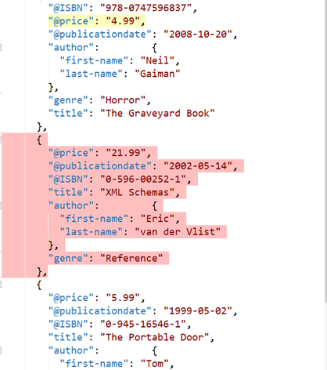
Delete the code

Slide 31
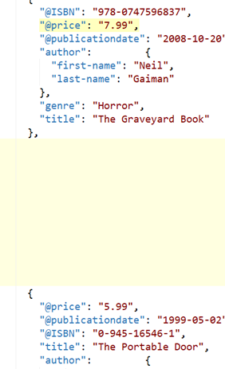
The code is deleted

Slide 32
Diff view
The diff view looks as follows, with the current API version on the right, and the other version on the left. Added lines are highlighted in green, modified lines - in blue, removed lines - in red.

Slide 33
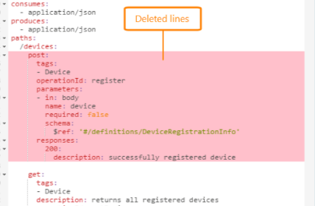
Delete the code

Slide 34
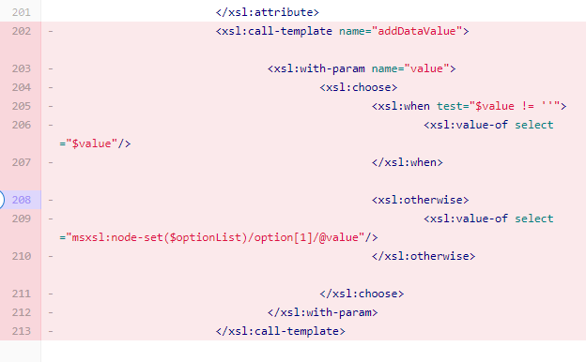
Delete the code

Slide 35
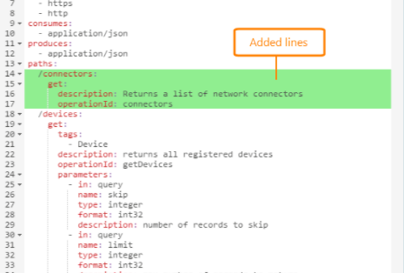
Add the code

Slide 36
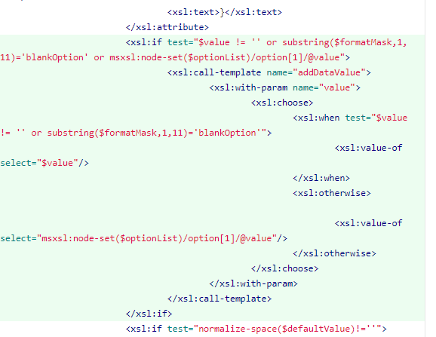
Add the code

Slide 37
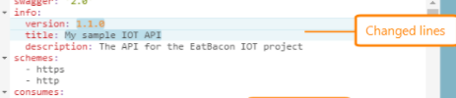
Changed lines

Slide 38
Merge differences
Click the highlighted difference line (or block) in the right or left part of the window. SwaggerHub will copy the block from the left side of the window to the right side (that is, to your API) and will remove highlighting. It will also increase the counter in the Undo button.
Click Undo to revert the most recent approval, if needed. To revert several approvals, click Undo several times.
After you merge all the needed differences, click Save Changes to save the changes. This will update the current version with the selected changes.

Slide 39
The Comparison Type option at the bottom controls what is being compared:
Comparison TypeDescriptionDesign + MetadataCompare both the OpenAPI keys and key values.
Design onlyCheck just the structure,
for example, new or deleted OpenAPI keys.
The differences in key values are ignored.
The key order in the definition is not considered a difference, unless you changed the key values or added or deleted some keys.

Slide 40
End of the document

